Slide 1
Thesis Defense: Analysis of Various Algorithmic Approaches to Software-Based APRS Packet Demodulation
By: Robert Campbell
Committee Members: Dr. John Bellardo, Dr. Bridget Benson, and Dr. Dennis Derickson

Slide 2
What is APRS?
Automated Packet Reporting System.
A digital communication method used by hams.
Encoded onto the Radio Using Bell 202

Slide 3
Bell 202
1200 Baud AFSK using 1200Hz and 2200Hz tones.
Audio Frequency Shift Keying – using multiple tones in the audible range to encode data.

Slide 4
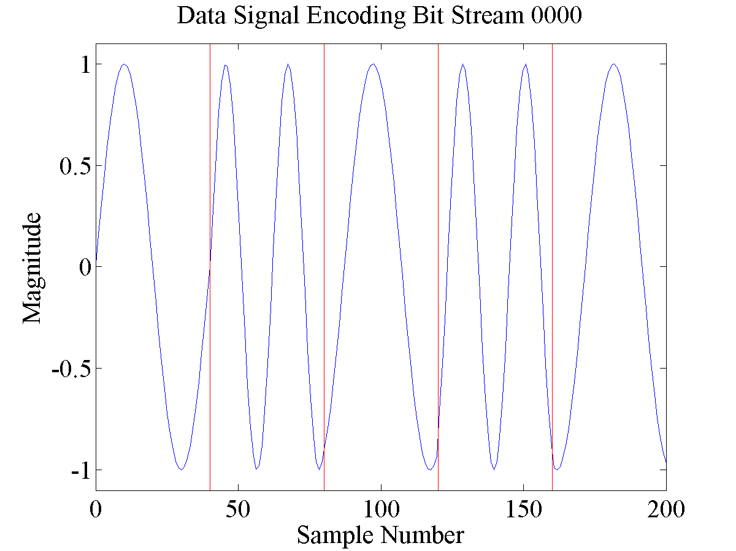
Example Signal

Slide 5
It’s in the audible range
What’s it sound like?

Slide 6
How does one demodulate this signal?
Edge Detection
Correlation
Filters
Phase Locked Loop

Slide 7
Edge Detection
Look for rising and falling edges
Distance between consecutive “zero-crossings” is λ/2

Slide 8
Correlation
Correlates original signal with expected signals.

Slide 9
Filters
Filters look at signal strength of individual frequencies

Slide 10
Phase Locked Loop (PLL)

Slide 11
Approaches to Accessing the Network
Terminal Node Controllers
Specialty APRS Hardware
Software

Slide 12
TNC Example: PK-232

Slide 13
TNC Example: MFJ-1278

Slide 14
TNC Example: Kantronics KAM

Slide 15
APRS Open Trackers

Slide 16
AGWPE

Slide 17
javAX25

Slide 18
Challenges
DC Offset
Noise
Emphasis

Slide 19
DC Offset

Slide 20
Noise

Slide 21
Emphasis

Slide 22
Algorithms Implemented
Zero Crossing
Goertzel (DFT / Filtering)
PLL
Preclocking

Slide 23
Zero Crossing

Slide 24
Goertzel (DFT / Filtering)

Slide 25
PLL

Slide 26
Preclocking

Slide 27
Benchmarking
OT3 Test
javAX25 Generated 200
OT3 Test + Ramping Noise
Track 1
Track 2

Slide 28
Clean Signal Example

Slide 29
Noise Example

Slide 30
Track 1 Example

Slide 31
Hardware Results - Clean

Slide 32
Hardware Results - Noise

Slide 33
Hardware Results – Track 1

Slide 34
Software Results - Clean

Slide 35
Software Results - Noise

Slide 36
Software Results – Track 1

Slide 37
Hardware versus Software

Slide 38
Ideas for Future Work

Slide 39
Conclusion

